Slide 1

GRAND CIRCUS LIGHTNING LESSON
This lightning lesson lays out the foundation for learning the concept of loops in Visual C#.
LOOPS
A loop is a block of code that’s specified once but may be carried out several times in succession.

Slide 2
github.com/PauloPolaco/GCExLoops https://repl.it
This lightning lesson lays out the foundation for learning the concept of loops in Visual C#.
LOOPS
A loop is a block of code that’s specified once but may be carried out several times in succession.

Slide 3
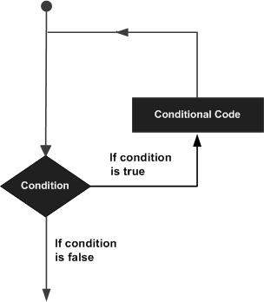
TYPES OF LOOPS
WHILE:
Repeats some code while a given condition is true.
DO … WHILE:
Tests the condition at the end of the loop body.
FOR:
Repeats some code for some specified range.
FOREACH:
Repeats some code for all items in a list or array.

Slide 4
WHILE LOOP Repeats some code while a given condition is true.
int number = 1;
while (number <= 10)
{
Console.WriteLine(number++);
}

Slide 5
DO … WHILE Tests the condition at the end of the loop body.
int number = 1;
do
{
Console.WriteLine(number++);
} while (number < 11);

Slide 6
FOREACH Repeats some code for all items in a list or array.
foreach (int number in fibonacciNumbers)
{
Console.WriteLine(number);
}
int[] fibonacciNumbers = new int[]
{
1, 1, 2, 3, 5, 8, 13, 21, 34, 55, 89, 144
};

Slide 7
FOR LOOP Repeats some code for some specified range.
for (int number = 1; number <= 10; number++)
{
Console.WriteLine(number);
}

Slide 8
NESTED LOOP An inner loop within the body of an outer loop.
for (int x = 1; x <= 10; x++)
{
for (int y = 1; y <= 10; y++)
{
Console.WriteLine("({0}, {1}) ", x, y);
}
}

Slide 9



RECURSION

Slide 10

INFINITE LOOP An endless loop that does not terminate.

Slide 11
BREAK STATEMENT Terminates the closest enclosing loop in which it appears.
foreach (int number in fibonacciNumbers)
{
Console.WriteLine(number);
if (number.Equals(specialNumber))
{
break;
}
}
int specialNumber = 13;
int[] fibonacciNumbers = new int[]
{
1, 1, 2, 3, 5, 8, 13, 21, 34, 55, 89, 144
};

Slide 12
CONTINUE STATEMENT Passes control to the next iteration of the closest enclosing loop in which it appears.
foreach (int number in fibonacciNumbers)
{
if (number.Equals(specialNumber))
{
continue;
}
Console.WriteLine(number);
}
int specialNumber = 13;
int[] fibonacciNumbers = new int[]
{
1, 1, 2, 3, 5, 8, 13, 21, 34, 55, 89, 144
};

Slide 13
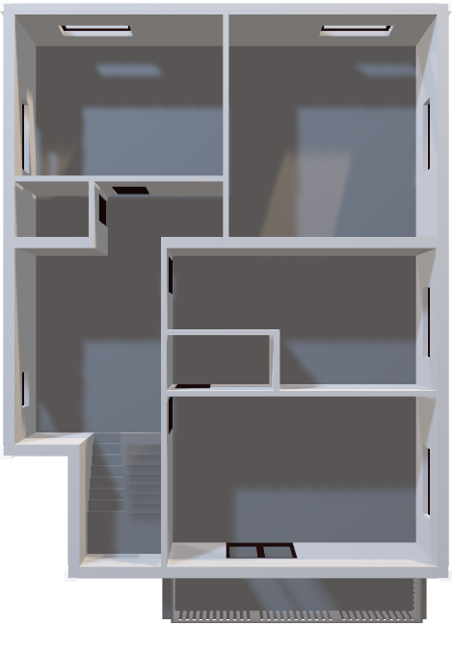

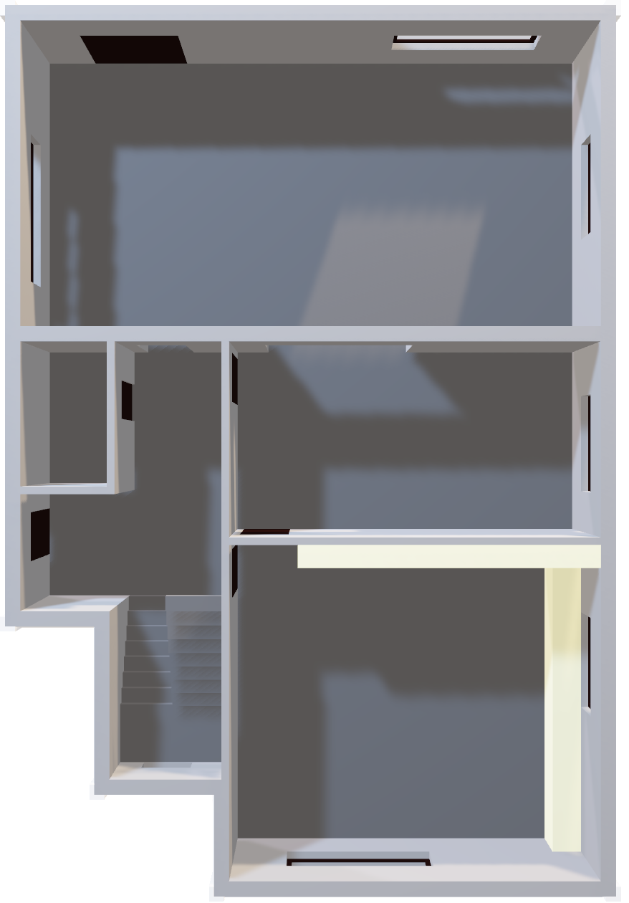
HANDS ON EXAMPLE
Write a FOR LOOP
that writes the numbers
from 1 – 10 backwards on the screen!
You can use the following to output
text to your screen:
Console.WriteLine(myValue);
… where myValue is the
name of your variable.
3rd Floor
2nd Floor
for (int i = 10; i > 0; i--)
{
Console.WriteLine(i);
}
[SHOW ANSWER]

